Slide 1
Cloud Native

Slide 2
Cloud Native
Distributed Applications
Component based
Stateless
Remotely managed
Automated (No manual intervention)
Light weight

Slide 3
Spring – Boot (Features)
Eliminates boiler plates
Embedded Server (Code, Configure, Server)
Minimum configuration (Auto configuration)
Starters dependencies
Single artifact – improves devops partialy
Manage remotely using –
Developer productivity

Slide 4
What is Microservices
Modular based (component based)
Loosely coupled
REST (API)
GRPC
Asynchronous (Broker)
MTLS
Independently deployable
Independently Scale
Available (fault tolerance, resilient)
Security

Slide 5

Why?
Ship features faster to the customers
Availability

Slide 6

Product release cycle
V 1
V 2
V 3

Slide 7
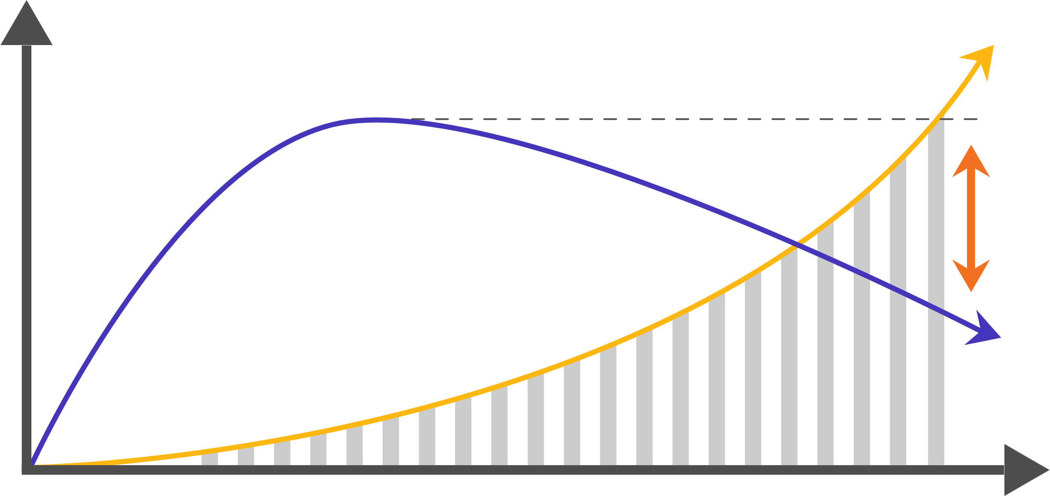
Features
Frequency of deployment
ROI
Domain Knowledge
Time
Spring Framework
XML Annotation
MVC
Hibernate
War Deployment
Manual Operation
Boot
Auto configuration
O Auth2.0
Data JPA
Container
Automated K8S

Slide 8

Search
Shipment
JAVA
Order
JAVA
Recommendation
Python
Invoice
Node Js
Security
OKTA
Inventory
Kotlin
Monolith Application Approach

Slide 9






Order
Search
Shipment
Invoice
(http GRRC messaging)
Inventory
Security

Slide 10
Application
Network
Infrastructure
Hardware

Slide 11
Monolith
Microservice
Centralized
Cannot afford failure
Decentralized
Availability even in case of failure

Slide 12
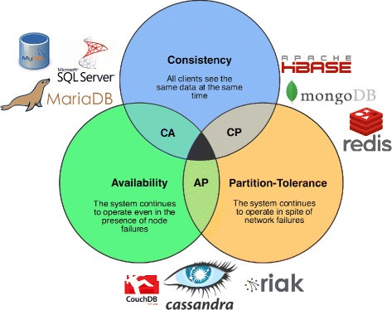
CAP Theorem

Slide 13



Ecommerce Application
Outsourced /
Of the shelve solution
OCTA Automation
Configuration wso2
Zoho /
Quick Books
Sub-domain
Order
Inventory
Invoice
Refund/
Returns
Freshdesk
Customer
Service
User
Management
Shipment
Payment
Cross Sub-domains
Maturity

Slide 14
Monolith
Configuration
DEV
Dev - War
Code
Server
Immutable
Platform / Java
OPS
OS
Server (Physical)
DEV / OPS

Slide 15
Spring Boot
Configuration
DEV
Code
Dev - War
Server
Immutable
Platform / Java
OPS
OS
Server (Physical)
DEV / OPS

Slide 16
Container
Configuration
Code
Server
Immutable
DEV
Dev - War
Platform / Java
OS
Server (Physical)
DEV

Slide 17

Client Side – Load Balancer
Registry Service
[IP1:port,IP2:port,IP3:port]
O
I
S
Microservices
Client

Slide 18
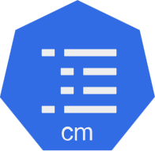
Order Microservice
App / Config 1
Application_dev.yml
App / Config 2
Application_qa.yml
Application_pro.yml
App / Config 3
Config map

Slide 19
DTO
By business capability
Decomposition
Domain driven design techniques
Controller
Model
Service
(DTO)
Layered Architecture
DAO (repository)
DB

Slide 20
Kubernetes (K8S)
Container creation
Container deletion
Scaling
Service discovery
Ingress
Deployment
Configure Management
Load Balancing

Slide 21
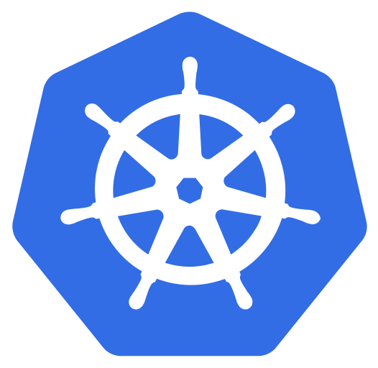
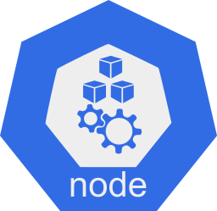
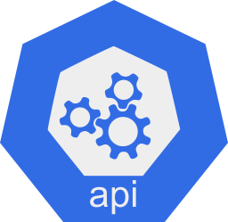
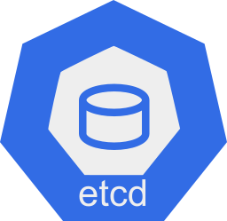
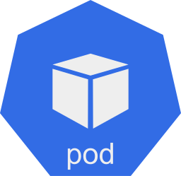
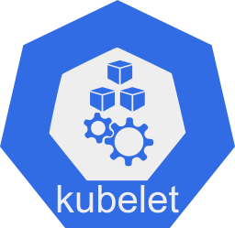

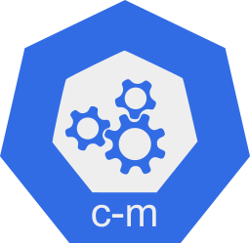
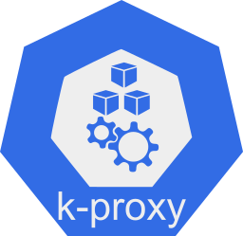
Kubernetes (K8S)
Worker node 1
Worker node 2
API Server
etcd
Scheduler
Worker node 3
Controllers
Control Plane
Data Plane
Client

Slide 22
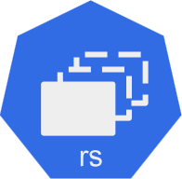


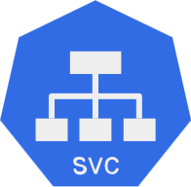
Cluster IP
Kubernetes (K8S - Cluster)
Replica-set
8222
[IP1 - 10.245.101.230]
80
8222
Container
User
Service
8222
App = Order – Microservices
(App = O - M)

Slide 23
Implementation - Options
Application (V1)
Container Orchestration (V2),(K8S)
Serverless (V3)
Spring Cloud
Netflix OSS components
Configuration service
Eureka SI
Ribbon
Cloud API Gateway
Docker, RKT, Container D
Platform as a service
Light weight, Resource, Optimized
As an offering by cloud provide
Concerns are pushed to the infrastructure
On Prem / Hybrid / Cloud
Vendor LockIn
Dev-Ops
No Dev-Ops needed
On Prem / Cloud
Application managed
Polyglot microservices
No Control
No Dev-Ops needed
Improves Security
Language dependent

Slide 24
Application & Profiles
Dev
Qa
Pro
Code

Slide 25

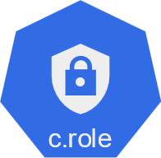
Server Side Load Balancer
Cluster IP
(Fixed IP)

Slide 26
Service to Service Communication
Kubernetes (K8S - Cluster)
Replica set (rs)
Replica set
6222
8222
80
80
6222
8222
Service
(svc)
Service
6222
80
8222
O
I
Service
8080
8080
8080
Replica set
S

Slide 27

Bottom Up approach
A
Jump
B
Contract
C
Mock
D

Slide 28
Top Down approach
A
B
Code
Contract
C
D

Slide 29
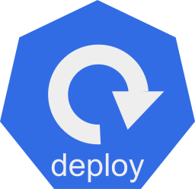

K8S - Deployment
Service
(svc)
Replica set (rs)
Order
Private Subnet
Public Subnet
Ingress
Service
(svc)
Replica set (rs)
Inventory
Private Subnet

Slide 30
Private Subnet
Public Subnet
Orders
Inventory
API - Gateway

Slide 31
Ingress
Service
Replica set (rs)
Service
Replica set (rs)
Service
Replica set (rs)
Service
Replica set (rs)
Service
Replica set (rs)
Service
Replica set (rs)
dev.classpath.com
qa.classpath.com
stage.classpath.com

Slide 32
Failure rate above threshold
Closed
Open
After wait duration
Failure rate above threshold
Failure rate above threshold
Half-Open

Slide 33

1
1
0
0
0
1
Ring Bit Buffer
0
1
0
0
1
1

Slide 34
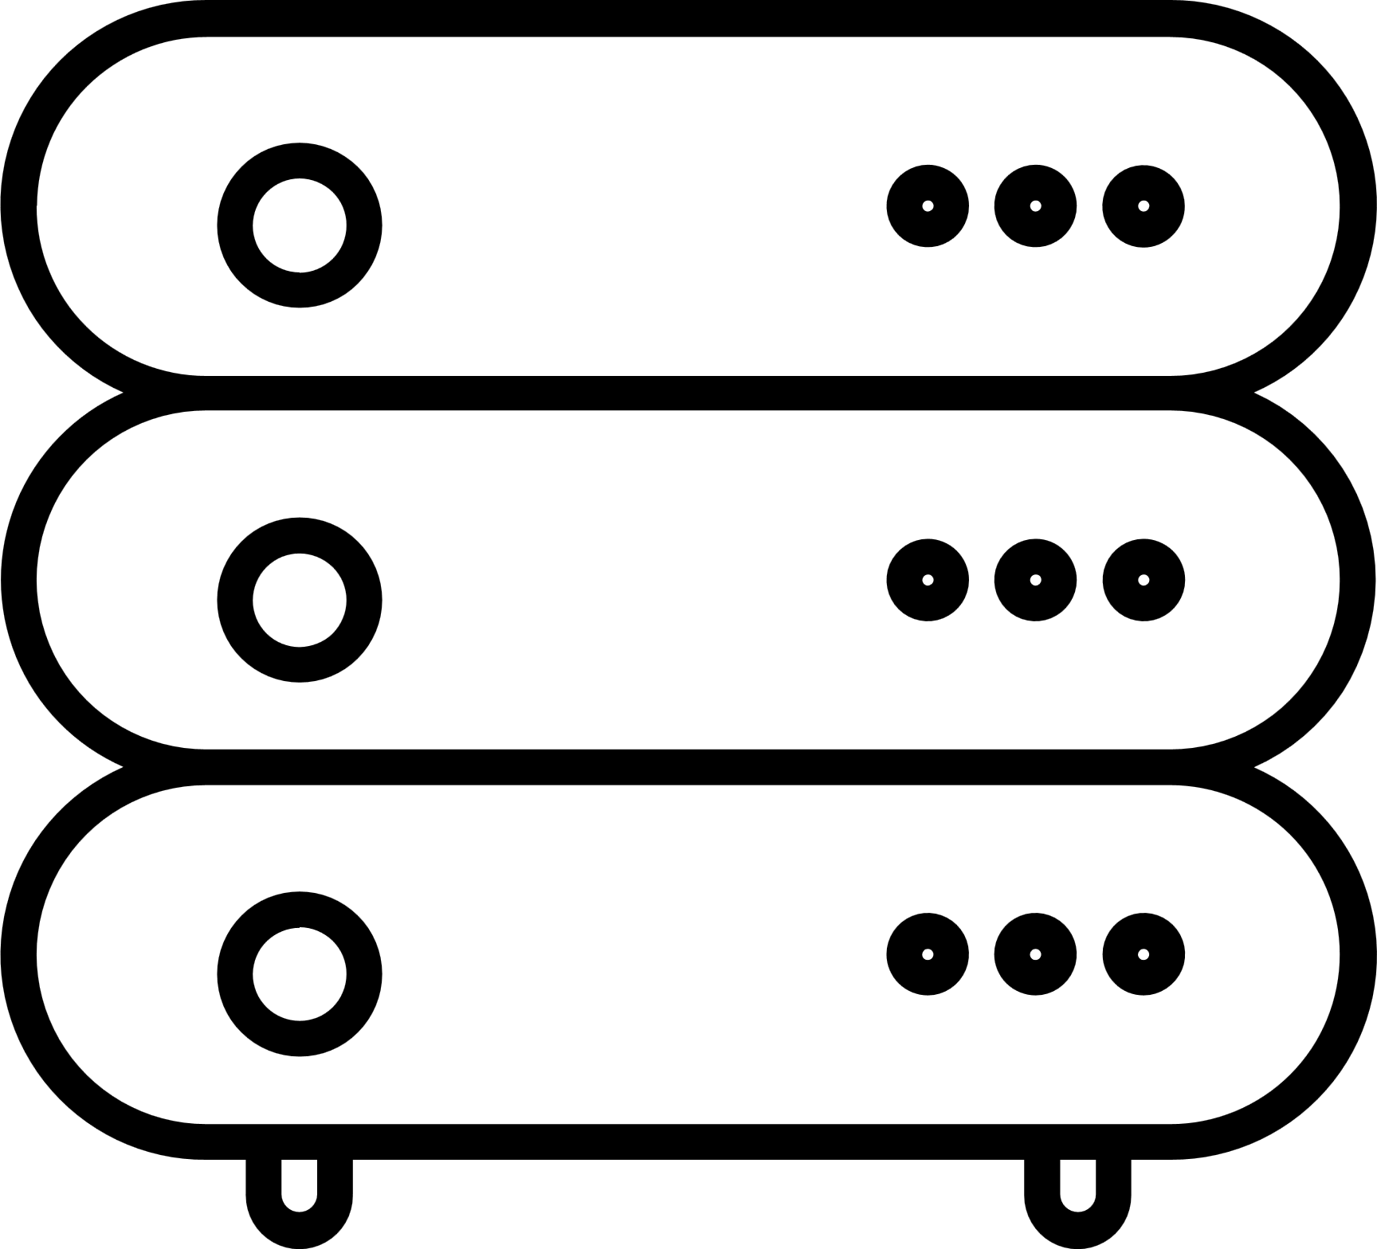

4. The OAuth2 server authenticates the user and validates tokens presented to it.
1. The service we want to protect
OAuth2 authentication server
Protected resource
The User
Application trying to access a protected resource
3. When the user tries to access a protected service they must authenticate and obtain a token from the OAuth2 service.
Resource owner
2. The resource owner grants which applications/users can access the resource via the OAuth2 service.

Slide 35
Service
Domain
Entity
<<Interface>>
Repository
<<ORM-Managed>>
Entity
RepositoryImpl
Persistence

Slide 36
Web Adapter
Persistence Adapter
Use Case
Input Port
Output Port
Entity
External System Adapter
External System Adapter
Input Port
Use Case
Output Port

Slide 37
Kubernetes (K8S)
Replica set – Version1
Pod
Pod
Pod
Pod
Replica set – Version2
Pod
Pod
Pod
Pod
Replica set – Version3
Pod
Pod
Pod
Pod

Slide 38

OAuth 2.0 Authorization Code Flow
Client
Authorization Server
Go to authorization server
Redirect URI: yelp.com/cb
(front channel)
accounts.google.com
yelp.com
Email
Connect with Google
contacts.google
Password
Resource owner
Request consent
from resource owner
Exchange code for access token
(back channel)
Talk to resource server
(back channel)
accounts.google.com
yelp.com/callback
Allow yelp to access your public
profile and contacts
Back to redirect URI
with authorization code
(front channel)
No
Yes

